Slide 1
A computer vision approach of waste sorting based on Dense Convolutional Networks
王子卓 夏苏安 徐欣尔

Slide 2
Waste Sorting - Meanings
Prevent polluting the water and soil
Save the cost of land by reducing landfilling
Re-use the resource

Slide 3
Waste Sorting - Difficulty
Current waste sorting work is mainly done manually.
Sort by workers: Human resource is costly.
Sort by residents: There will always be some mistakes.

Slide 4
Waste Sorting - Computer vision approach
The cost of human resource can be greatly deducted.
Provide a precise result.
Promote the recycling ratio
Bring economic benefits in the long term.

Slide 5
Methodology - DenseNet
Deeper net structure: ResNet
Wider net structure: GoogleNet Inception
DenseNet: make better use of feature

Slide 6
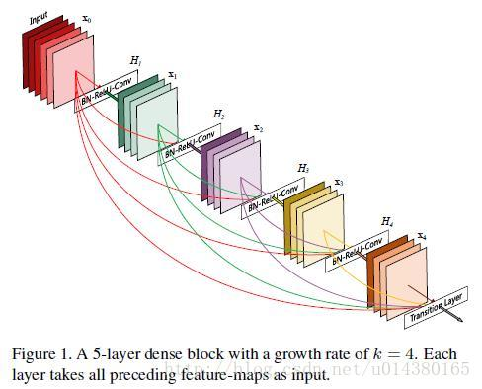
Methodology - DenseNet
Enhance the transmit of feature

Slide 7
Methodology - DenseNet
Reduce # of parameters
Easier to train models
“Each layer has direct access to the gradients from the loss function and the original input signal, leading to an implicit deep supervision.”

Slide 8
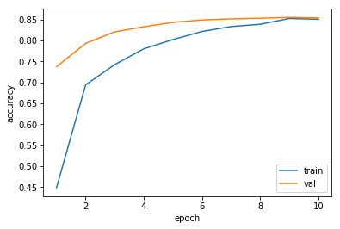
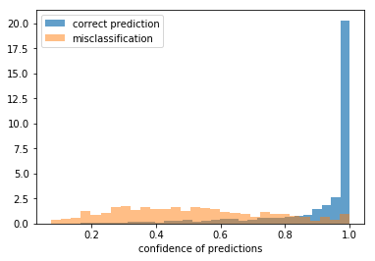
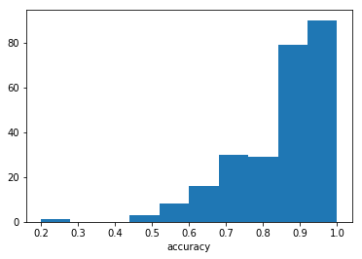
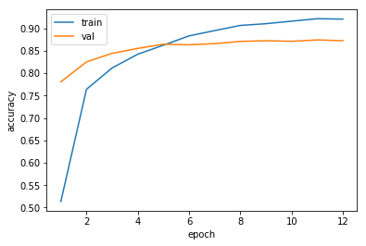
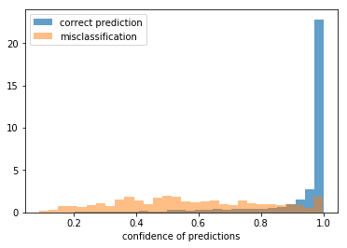
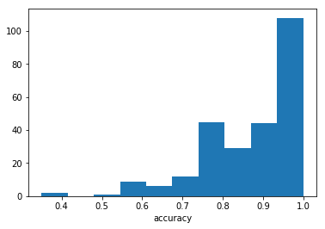
Results – DenseNet121 & DenseNet201

Slide 9
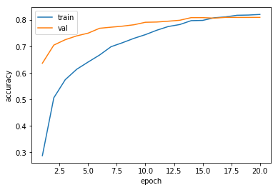
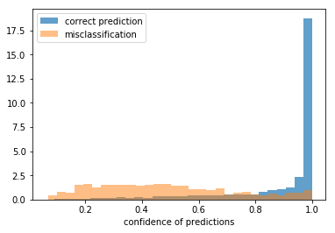
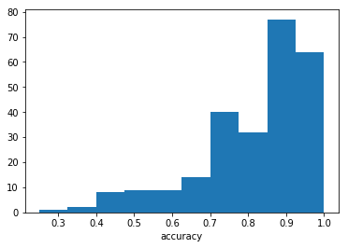
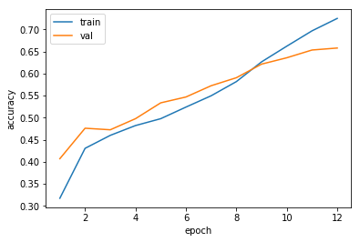
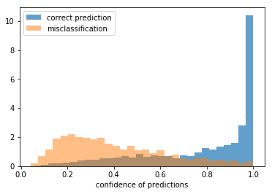
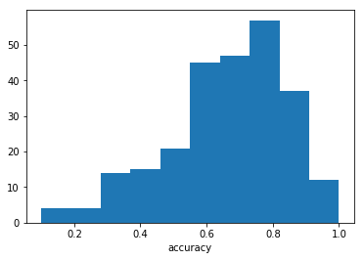
Result – ResNet & SqueezeNet

Slide 10
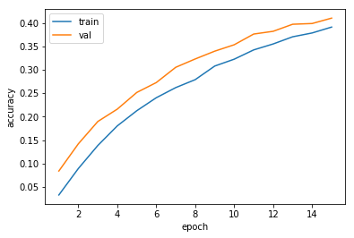
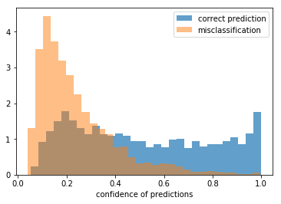
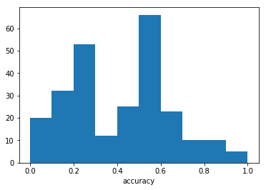
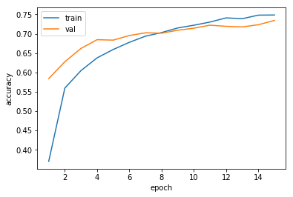
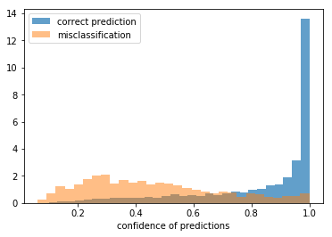
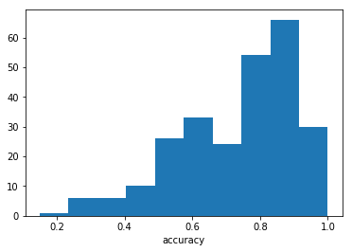
Results – Binary & Ternary weight network

Slide 11
Future works
More training
More kinds of feature: smell, temperature, weight

